Slide 1


A Survey of Streaming Services
Summer Kenney –ENTITY Academy
Caitlin McDaniel- ENTITY Academy
Jaclyn Huff- ENTITY Academy

Slide 2
“Life imitates art far more than art imitates life” - Oscar Wilde
Whether art acts as a harbinger, mirror, or influencer is a matter better left to the philosophers.
But regardless of where you land, it is clear that art changes with the times. The most widely consumed art of our generation is that of movies and shows.
There were an estimated 5.41 Billion television viewers in 2022. And far and above the most common method of viewing is the increasingly popular streaming services. In 2022, over 85% of U.S. households had at least one video streaming subscription.
Jaclyn Huff , Caitlin McDaniel and Summer Kenney compiled data from three key streaming services: Netflix, HBO, and Hulu to examine the trends in streaming services, how they compare to one another, and how time has influenced those trends.
“We live in a box of space and time. Movies are windows in its walls.” - Roger Ebert

Slide 3
Meet the Team - Caitlin McDaniel
26 Years old
Place of employment: Arkansas State Claims Commission
Title: Administrative Specialist II
Children: (1) Jaice ; 6 Years Old
Experienced in legal claims, adjusting, data entry and more.

Slide 4
Meet the Team-Jaclyn Huff
Prior to studying Data Science, I worked in medical research for 18 years as an SRA.
I am a certified Thai Reflexologist and a certified Strategic Life Coach. I'm also a practicing Mindfulness Practitioner.
I am passionate about how technology is changing the world around us and seeing how it can improve the medical system.

Slide 5

Meet the Team- Summer Kenney
Life-long learner
Excellent Soft Skills
Background starting and managing small businesses
Curated and ran successful marketing campaigns for several companies.
Enthusiastic and excited about data and the way it can impact the world.
Scientist at heart

Slide 6
NETFLIX
I can still remember the excitement of running to our mailbox to see if our latest Netflix DVD had come in the mail!
Fast forward two decades and Netflix has become one of the biggest TV and movie studios in the world, with more subscribers than all the cable TV channels in America combined.

Slide 7
Netflix Key Statistics
Netflix generated $24.9 billion revenue in 2021, a 23.8% increase year-on-year
$12.97 billion of Netflix’s revenue was generated in North America, its largest market
Netflix had an operating profit of $5.1 billion in 2021, an 85% increase year-on-year
In 2022, Netflix had 222 million subscribers worldwide

Slide 8
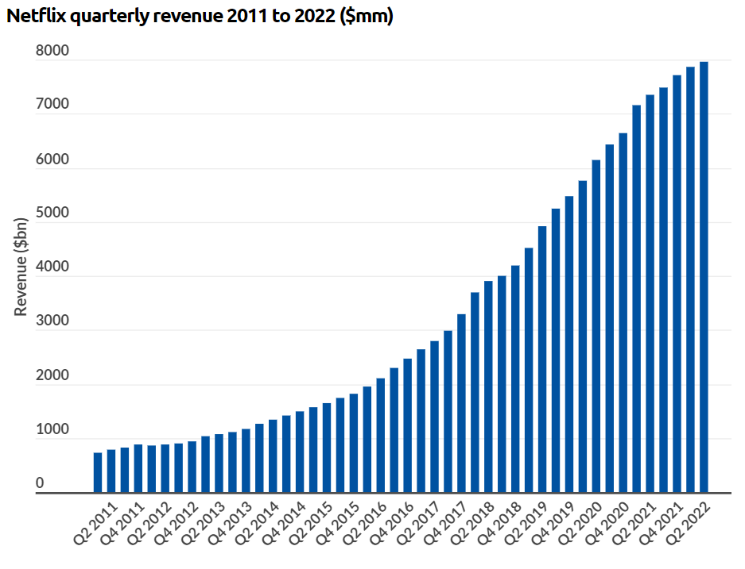
Netflix Revenue
Netflix generated $24.9 billion revenue in 2020, a 23.8% increase on the previous year. It has reported higher revenues each quarter for more than a decade.

Slide 9
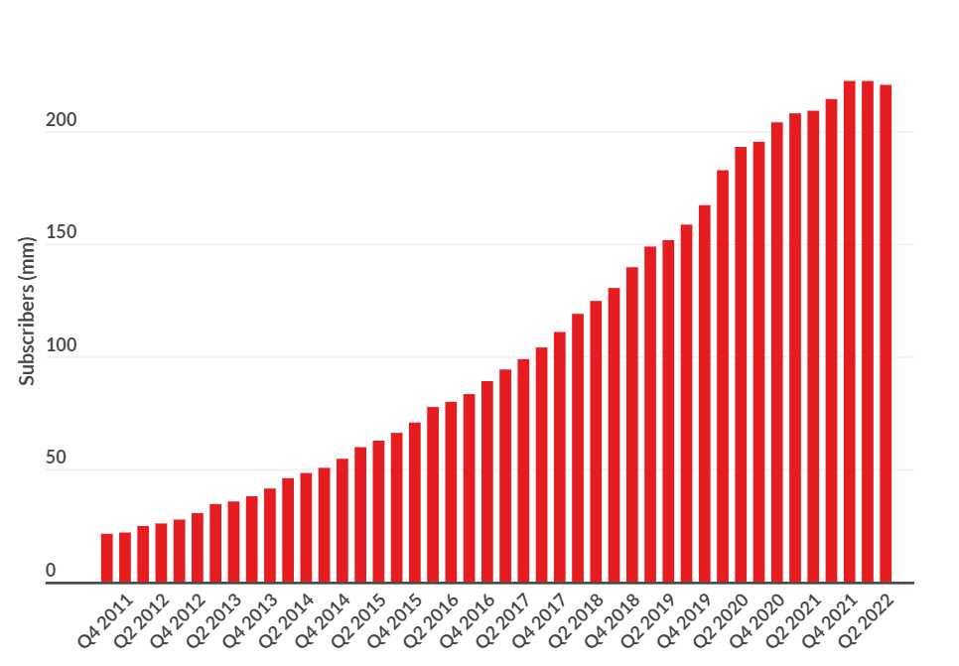
Netflix Subscribers
Netflix reached 222 million subscribers in 2021, but stalled in Q1 2022, losing 200,000 subscribers and wiping over 50% off its market cap.

Slide 10

Netflix FAQ’s
What is the most streamed TV show on Netflix?
The Office is the most streamed piece of content on Netflix, with a total of 57.1 billion minutes
What is the median age of a Netflix user?
The median age is between 35-44 years old
How many Netflix users use the platform without paying?
An estimated 31% of users do not pay for the platform
How many unique recommendations does Netflix have?
Netflix has 1,300 “recommendation clusters”, which are built through user’s viewing preferences
How many hours of Netflix were streaming during coronavirus lockdown?
In the US, an estimated 204 million hours were collectively streamed during the first major coronavirus lockdown in 2020

Slide 11
Data Set Examined This dataset, taken from Kaggle.com contains +5k unique titles on Netflix with 15 columns containing their information, including:
id: The title ID on JustWatch.
title: The name of the title.
show_type: TV show or movie.
description: A brief description.
release_year: The release year.
age_certification: The age certification.
runtime: The length of the episode (SHOW) or movie.
genres: A list of genres.
production_countries: A list of countries that produced the title.
seasons: Number of seasons if it's a SHOW.
imdb_id: The title ID on IMDB.
imdb_score: Score on IMDB.
imdb_votes: Votes on IMDB.
tmdb_popularity: Popularity on TMDB.
tmdb_score: Score on TMDB.

Slide 12
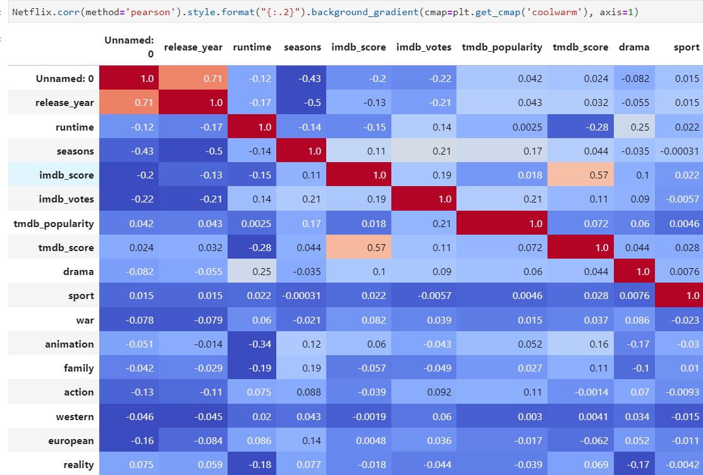
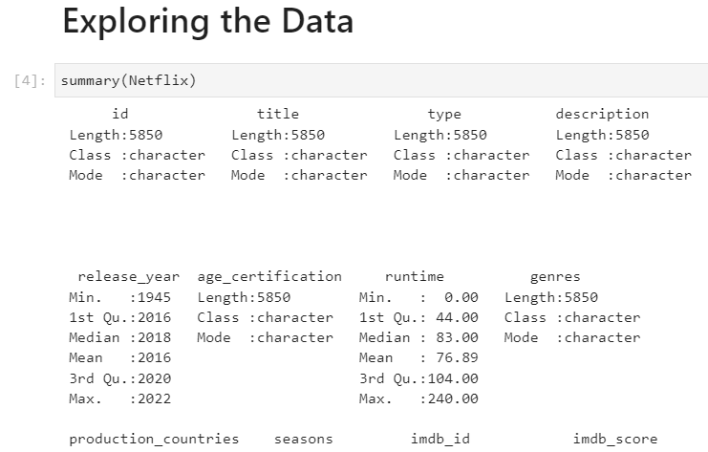
Data Set Exploration
The team uploaded the data set into an R notebook. They wanted to find out how many rows (5,850), and columns (15). They also examined the column types (char, int, etc.).
Next, the team opened a Python notebook and continued to explore the data, looking at how many null values were present, the data types, etc. They created a correlation matrix to be able to have a cursory perusal of any correlations between factors.

Slide 13



Continuing the Exploration
The first thing that piqued their interest was regarding whether a show’s rating had a correlation to its popularity score (IMDB in this case) so the team asked this question:
Is there a difference in IMDB scores among the age certifications of TV-MA(mature audience), TV-Y(child audience), and TV-G(general audience)?

Slide 14
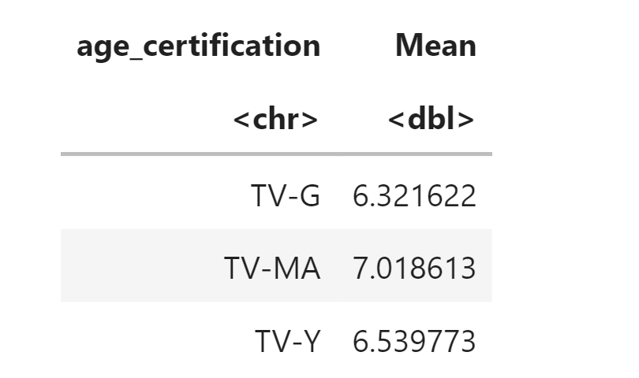
Answering the Question
The team pulled out only shows from the data set that had the selected ratings and chose to run a 1 way, between-subject ANOVA (analysis of variance) on the three ratings. They tested for all necessary assumptions and upon computing post hoc found that there was a significant difference in score between G rating and MA rating and between Y and MA rating. There was not a significant difference between G and Y ratings.
They examined the means to draw some conclusions. What they found was that television with a rating of ‘MA’ had significantly higher IMDB scores than television that was made for children and a general audience (Y and G)!

Slide 15
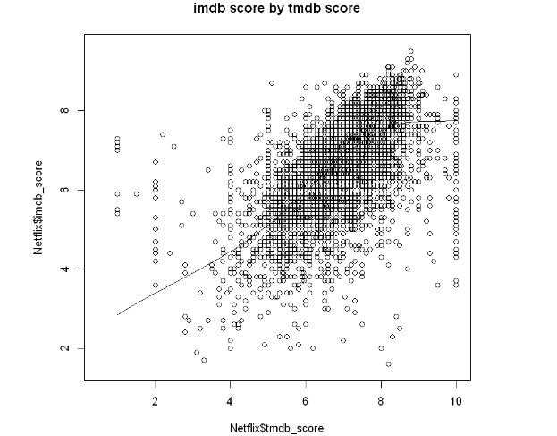
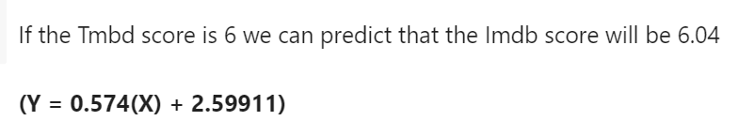
Creating a Linear Model
The team wanted to look closer at the popularity ratings themselves and for this data set, we had two: IMDB and TMDB.
The team wanted to answer the question: How are the TMDB and IMDB scores related?
They created a test for linearity that passed, which means that there is a linear relationship between the two ratings. Once all the assumptions were met, they were able to create a prediction model that could predict a show or movie's IMDB score based on a given TMDB score.

Slide 16

Those proved to be interesting insights into the data, but as the team began to work together, they decided to put an emphasis on how shows and movies have changed through the decades.

Slide 17
The team ran a stepwise regression to see what the strongest correlating factors were given for ‘release year’. The strongest correlations shown were:
1. runtime
2. age_certification
3. imdb/tmbd_scores
4. number of seasons.

Slide 18
After considering the exploratory tests they decided to examine the following three questions:
Have movie and show times changed through the decades? If so, how?
Have IMDB ratings changed for movies and shows over the decades? If, so how? And,
How do IMDB scores compare among the various streaming services of Hulu, Netflix, and HBO?

Slide 19



The first thing that the team did was break up the release year into 3 separate decades: 1990-1999, 2000-2009, and 2010-2019 – 90’s, 00’s 10’s

Slide 20
QUESTION1: How have running times changed through the decades?
In order to answer the first question, they needed to first explore the means of each and see how they compared to one another. The test for variance for both shows and movies came back with the result that there IS a significant difference between run times over the decades!
So, they went back to look at the averages and found the following…

Slide 21
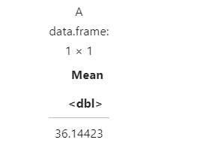
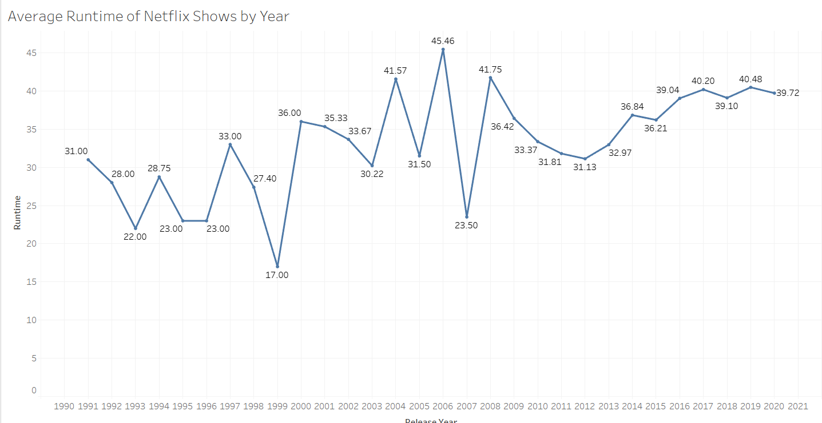
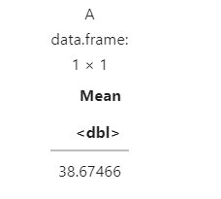
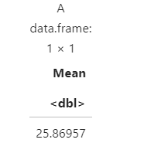
Runtimes for Netflix shows were considerably shorter in the 1990’s but remained fairly constant for the last two decades.
2020’s average runtime for shows
2010’s average runtime for shows
1990’s average runtime for shows

Slide 22
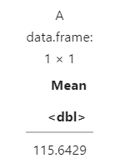
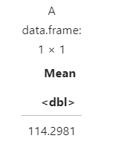
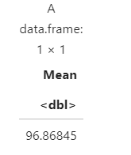
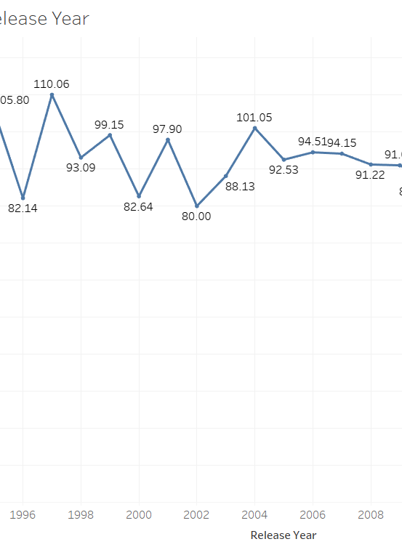
Movie times were considerably longer in the 90’s and 00’s than in the last decade. Movie times have decreased significantly since 2010.
1990’s average movie time
2000’s average movie time
2010’s average movie time
All decade's average movie time

Slide 23
QUESTION 2: Have IMDB ratings changed for movies and shows over the decades? If, so how?
Running the same tests on IMDB scores as they did on runtimes over the decades showed that there is some statistically significant variance to be explored!

Slide 24
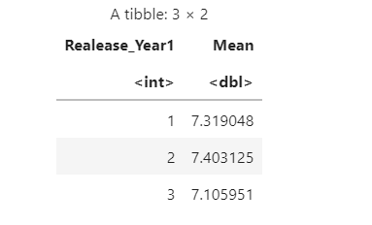
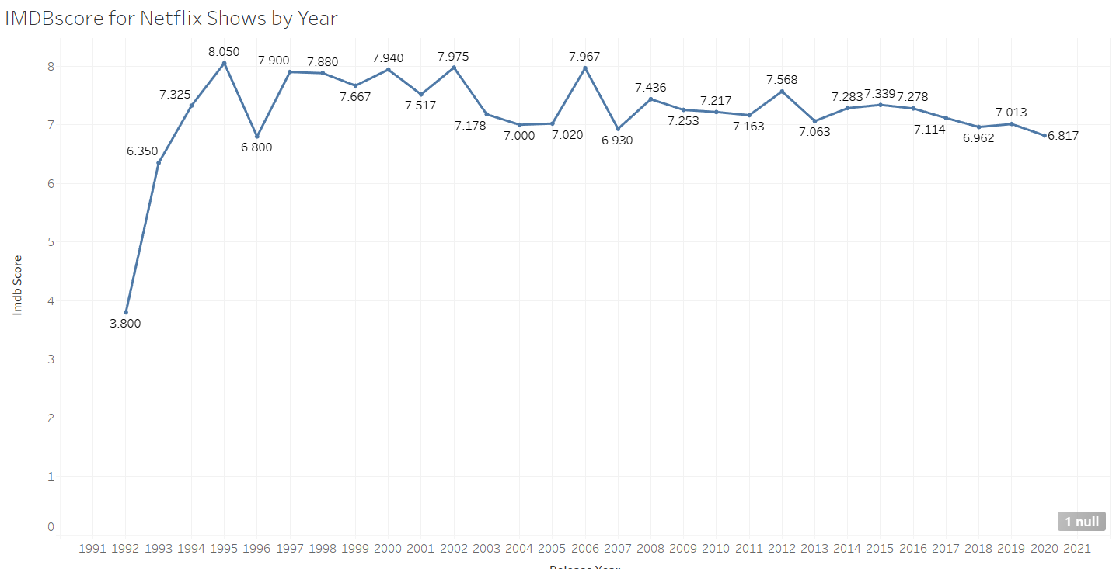
IMDB scores for shows have declined in the last decade.
1 = 1990-1999
2 = 2000-2009
3 = 2009-2019
We can see that while the ratings for shows have not varied drastically, the most recent decade shows a slight decline in average rating.

Slide 25
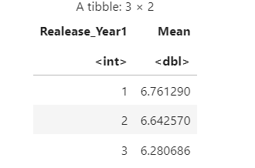
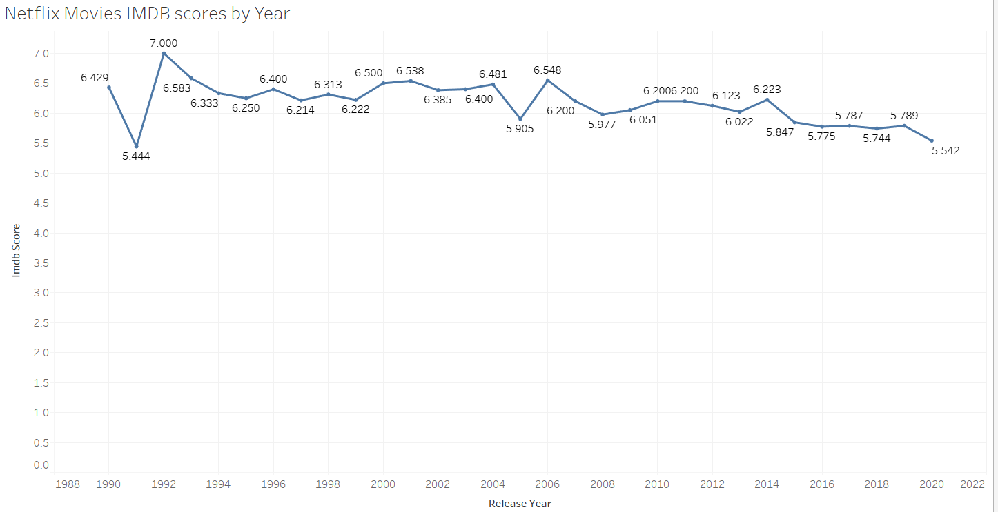
IMDB scores for movies have declined in the last decade.
1 = 1990-1999
2 = 2000-2009
3 = 2009-2019
Once again, we can note a decline in average ratings in the most recent decade. Interesting to note is how the movie IMDB ratings are significantly lower than the show IMDB ratings.

Slide 26
Combining the Data Sets
Now that the team had some interesting insights into the Netflix data set, they wanted to see how it compared to some of the other major streaming services.
They combined the Netflix data set with a Hulu and HBO data set to make one big streaming services data set.
They took some time to explore this new combined data set in both python and R.
Once they found the mean IMDB scores for the combined data set for both movies and shows, it was time to compare!

Slide 27
How does Netflix measure up?
The team ran a T-test to see if the average IMDB scores for Netflix were the same as the average IMDB scores for the combined data set.
First up was movies. The test showed that there IS a significant difference between the overall average IMDB score and the Netflix IMDB score for movies.
Next the test for shows revealed that there was NOT a statistically significant difference between the Netflix average and the overall average.

Slide 28
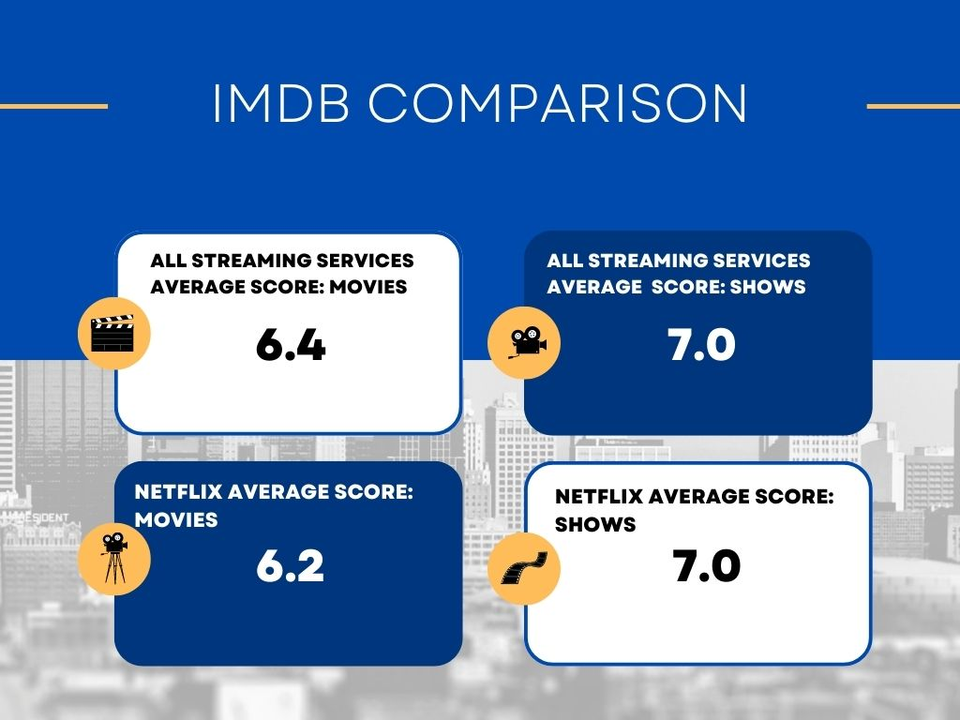
Netflix movies scored lower than the overall average
Netflix shows scored the same as the overall average.

Slide 29
Netflix Summary
Netflix content intended for more mature audiences garner higher popularity ratings than Netflix’s content for a younger or family audience.
Netflix television shows were significantly longer in the 1990’s than in recent decades.
Netflix movie times have decreased significantly since 2010.
Television shows have shown a decrease in IMDB ratings in the last decade.
Movie IMDB ratings have decreased in the last decade.
The average IMDB rating for shows is on par with the competition but the IMDB ratings for movies is significantly lower than the competition.

Slide 30
HBO MAX

Slide 31
HBO Max
HBO Max was launched in the United States on May 27, 2020. However, I am pretty sure most people have memory of seeing HBO movies from years before then.
According to AT&T, HBO and HBO Max had a combined total of 69.4 million paying subscribers globally on June 30, 2021, including 43.5 million HBO Max subscribers in the U.S., 3.5 million HBO-only U.S. subscribers (primarily commercial customers like hotels), and 20.5 million subscribers to either HBO Max or HBO by itself in other countries. By the end of 2021, HBO and HBO Max had a combined total of 73.8 million paying global subscribers. At the end of Q1 2022, HBO and HBO Max had 76.8 million global subscribers.
Pretty impressive

Slide 32
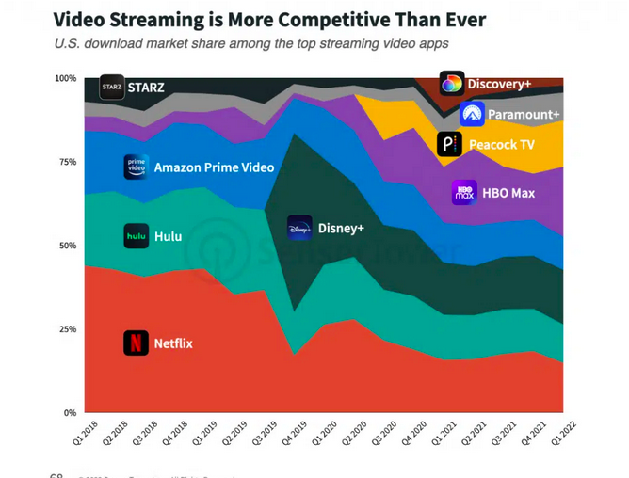
+ HBO Max led in market share of US app downloads with 21% in Q1 2022, followed by Disney+ and Netflix. The video streaming app was also among the top apps with the highest monthly active users with 10% of market share. The platform has had success adding new users since with its U.S. market share climbing from 4.5% in Q2 2020 to 10% in Q1 2022.

Slide 33
Data Set Examined:
/Users/caitlinbailey/Downloads/archive(2)/HBOtitles1.csv
This dataset, taken from Kaggle.com contains +5k unique titles on HBO Max with 15 columns containing their information, including:

Slide 34
Data Set Examined
id: The title ID on JustWatch.
title: The name of the title.
show_type: TV show or movie.
description: A brief description.
release_year: The release year.
age_certification: The age certification.
runtime: The length of the episode (SHOW) or movie.
genres: A list of genres.
production_countries: A list of countries that produced the title.
seasons: Number of seasons if it's a SHOW.
imdb_id: The title ID on IMDB.
imdb_score: Score on IMDB.
imdb_votes: Votes on IMDB.
tmdb_popularity: Popularity on TMDB.
tmdb_score: Score on TMDB.

Slide 35
Data Set Exploration
First, I installed and opened binary packages such as dplyr, ggplot, rcompanion, and many more.
Then I uploaded the dataset in Jupyter Notebook (r)
I also viewed the dataset which showed a data frame of 5850 x 15

Slide 36
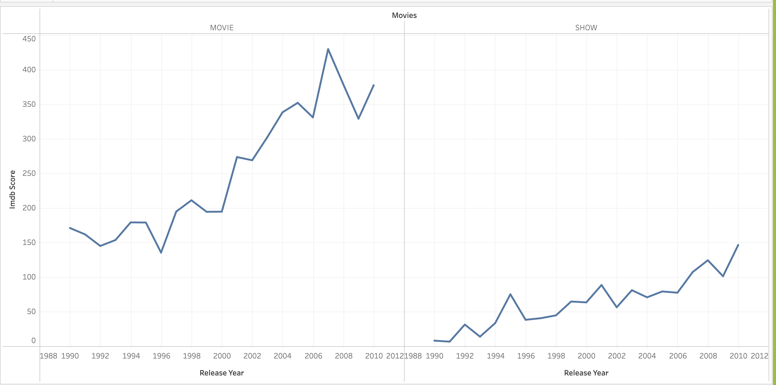
Have average IMDB scores changed for shows and movies over the decades?

Slide 37
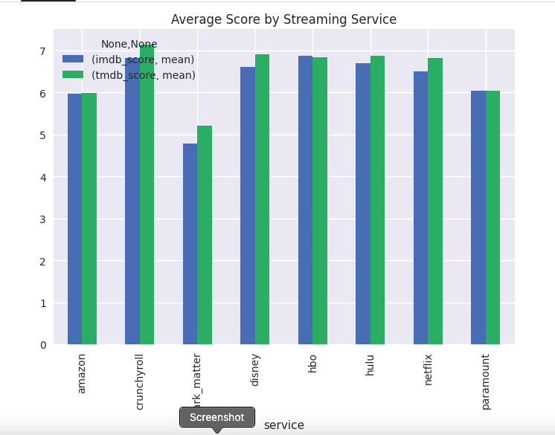
Tableau was considerably funny to work with. In terms, we wanted to know the average IMDB scores for movies and shows over the decades. After a bit of coding, 6.24 is the average IMDB score for all HBO Max Movies in the years of 1990-2020
6.97 is the average IMDB score for all HBO Max Shows

Slide 38
How have movie times changed throughout the decades?
The overall MeansRunTime for the 90’s is 96.57
00’s is 92.27
10’s is 76.29
There is a slight difference in the 90’s and 00’s. However, MeansRunTime for MOVIE were lower in the 10’s

Slide 39

Perform a T-test using the combined data set's averages as mu and your data set's average as the sample mean.
One Sample t-test data: HBOtitles1MOVIE$imdb_score t = 2.4279, df = 3428, p-value = 0.01524 alternative hypothesis: true mean is not equal to 6.2 95 percent confidence interval: 6.208997 6.284499 sample estimates: mean of x 6.246748
One Sample t-test data: HBOtitles1SHOW$imdb_score t = -0.90215, df = 1938, p-value = 0.3671 alternative hypothesis: true mean is not equal to 7 95 percent confidence interval: 6.929942 7.025912 sample estimates: mean of x 6.977927

Slide 40
How have show times changed throughout the decades?
The overall MeansRunTime for the 90’s is 98.57
00’s is 36.14
10’s is 38.67
There is a huge differencein the 90’s and 00’s. However, MeansRunTime for SHOW’S were lower in the 00’s

Slide 41
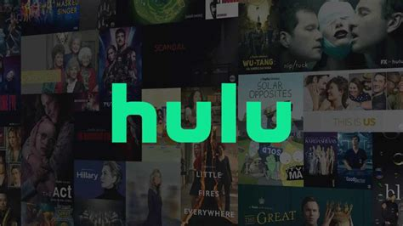
Online Streaming

Slide 42
Hulu
Hulu is known as an American subscription streaming service owned by The Walt Disney Company. It was launched on October 29, 2007, and it offers a library of films and television series from networks like ABC, and FX Networks, and among others, as well as Hulu original programming.
2017, Hulu had launched it’s live TV Service.
As of July 2022, Hulu has a total of 46.2 million subscribers.

Slide 43
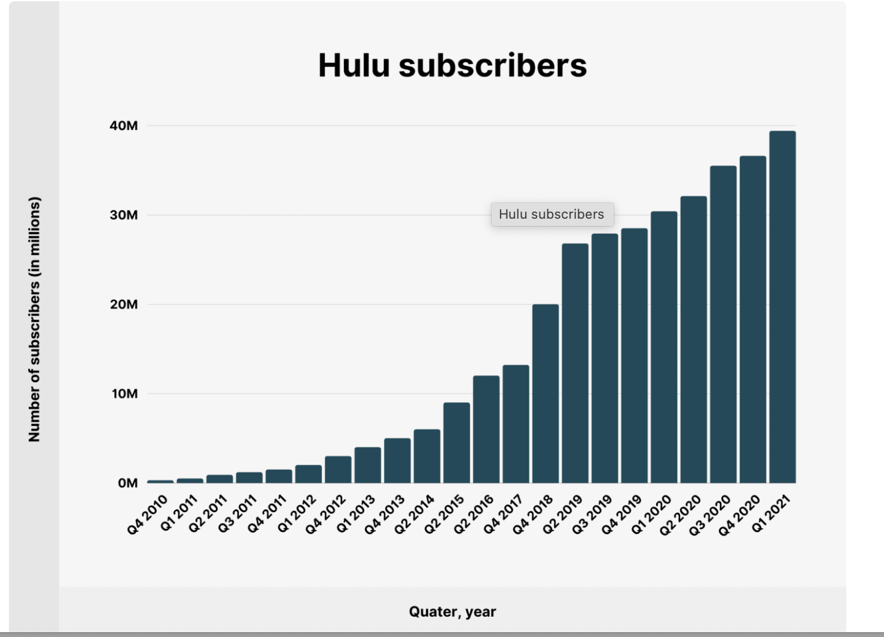
Over the last 8 years, Hulu has grown its paid subscriber base by 33.1%.

Slide 44
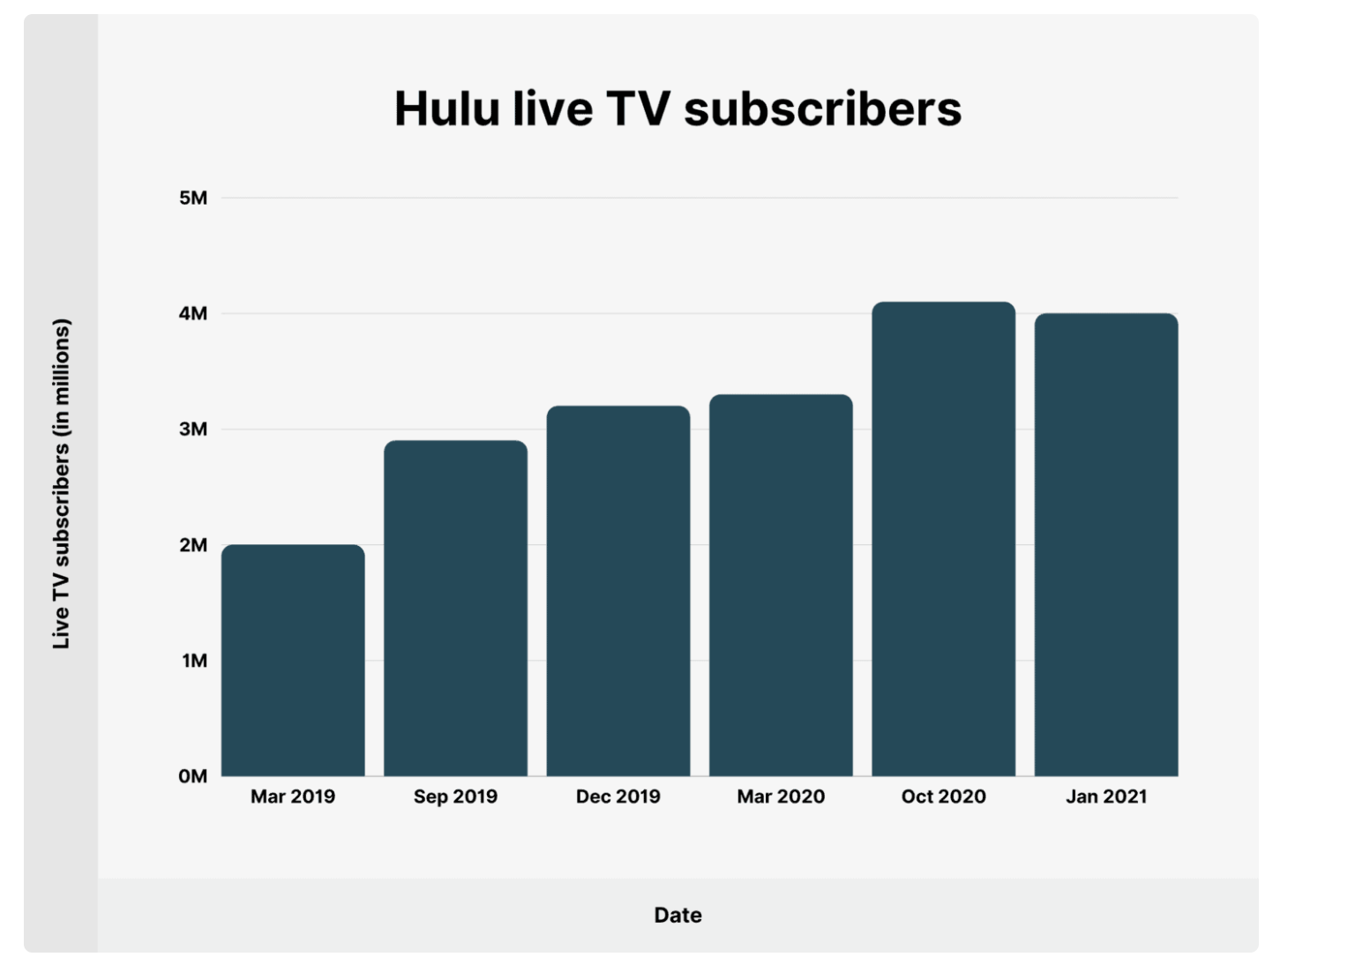
Hulu Live Tv package has added 4 million subscribers. The package provides access to live programming in addition to the on-demand library. During the last year (December 2019 – January 2021), Hulu added 800 thousand new live TV subscribers.

Slide 45
Data Set Examined This dataset, taken from Kaggle.com contains titles on Hulu with 15 columns containing their information, including:
id: The title ID on JustWatch.
title: The name of the title.
show_type: TV show or movie.
description: A brief description.
release_year: The release year.
age_certification: The age certification.
runtime: The length of the episode (SHOW) or movie.
genres: A list of genres.
production_countries: A list of countries that produced the title.
seasons: Number of seasons if it's a SHOW.
imdb_id: The title ID on IMDB.
imdb_score: Score on IMDB.
And More.

Slide 46
QUESTION1: How have running times changed through the decades?
I had to investigate the means of each and see how they compared to one another. Nonetheless, after looking at the sample size present in three individual decades I noticed that there was quite a considerable gap, so a traditional ANOVA probably would not be the best test to run in these circumstances. After reviewing, I ran the ‘Kruskal-Wallis’ test for conflict when the data is non-parametric.
The test for both shows and movies came back with the outcome that there IS a significant difference between run times over the decades.

Slide 47
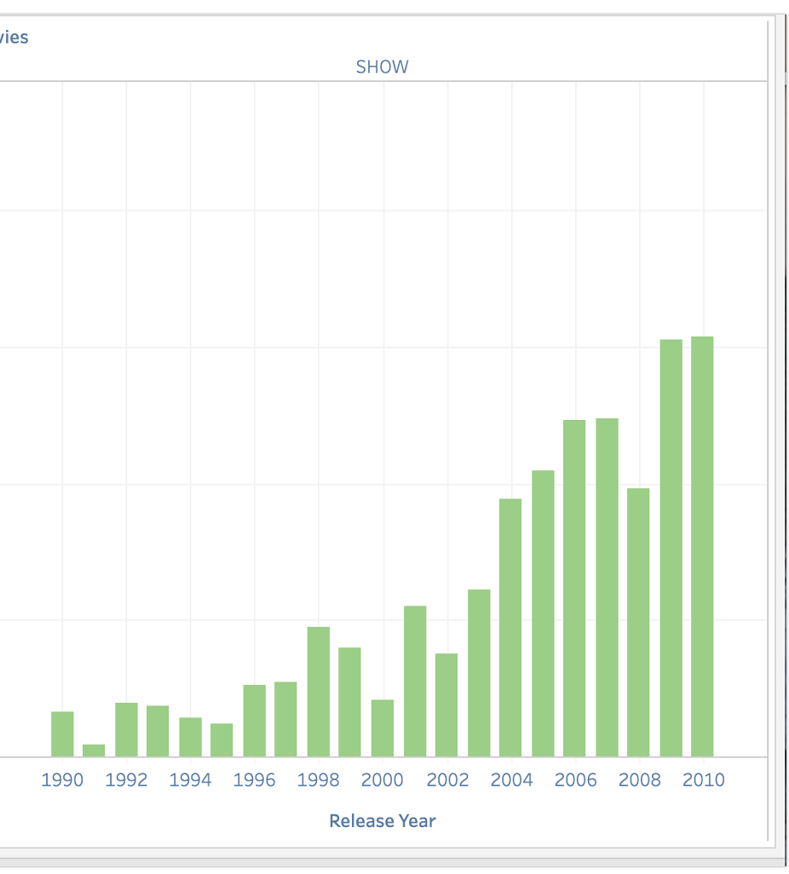
Show runtimes for Hulu were shorter in the 1990’s.

Slide 48
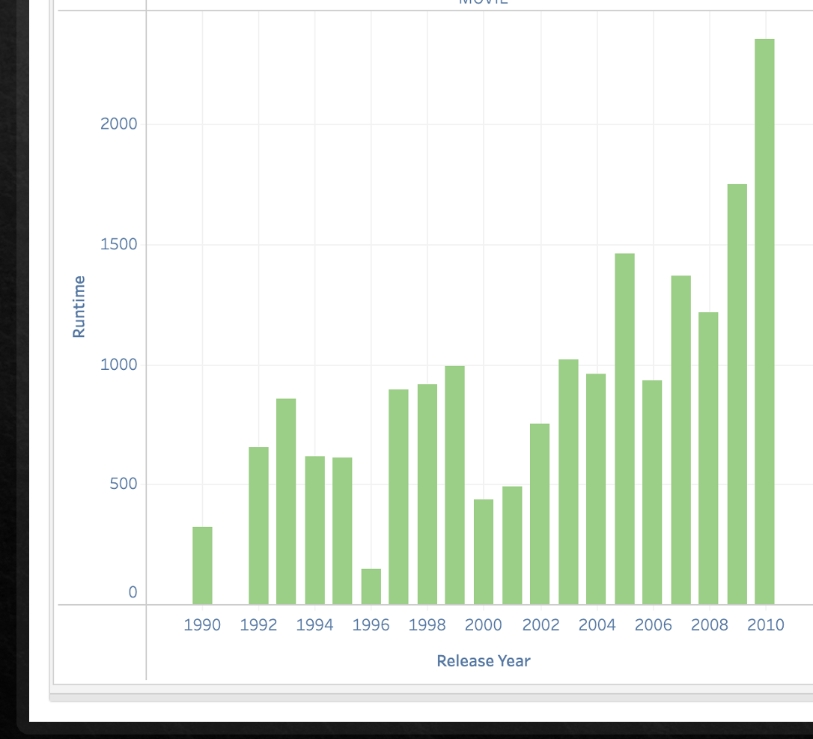
Movies runtime for Hulu were longer in the 1990’s.

Slide 49
QUESTION 2: Have IMDB ratings changed for movies and shows over the decades? If, so how?
Running the Kruskal-Wallis for the IMDB scores as I did on runtimes over the decades showed that there is some statistically noteworthy to be explored.

Slide 50
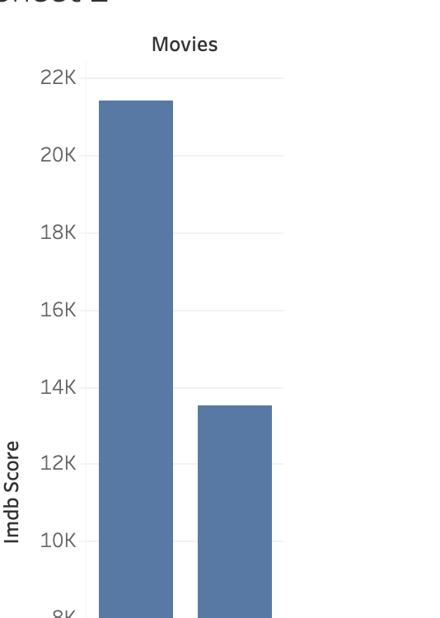
How have IMDB scores changed for shows and movies over the decades?

Slide 51
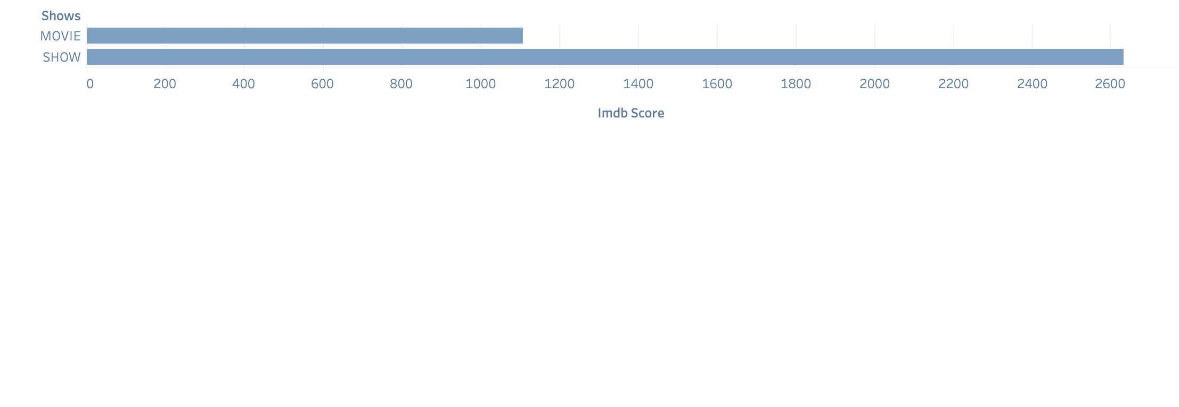
How have IMDB scores changed for shows and movies over the decades?

Slide 52
Now that we can see after running the IMDB Score, it shows that Tv shows are more popular than movies.

Slide 53
I ran a T-test to see if the average IMDB scores for Hulu were the same as the average IMDB scores for Netflix and HBO. After exploring the data in movies, it does show there's a significant difference between the average IMDB score against HBO, not by much against Netflix. The following test for TV shows revealed that there was not a statistically significant difference between the Netflix average and the overall average
Does Hulu Measure up against HBO and Netflix

Slide 54
Combining the Data Sets
After I had a great understanding of the Hulu data set, I wanted to see how it compared to some of the other major streaming services.
I merged the Hulu data set with a Netflix and HBO data set to make one big streaming services data set.
I took some time to research this new blended data set in R.
Once I discovered the mean IMDB scores for the combined data set for both movies and shows, it was time to compare!

Slide 55
IMDB Comparison
One Sample t-test
For Hulu Shows IMDB_SCORE
t = 4.6823, df = 1249, p-value = 3.147e-06
alternative hypothesis: true mean is not equal to 7
95 percent confidence interval:
7.085988 7.210012
sample estimates:
mean of x
7.148
One Sample t-test
For Hulu Movies IMDB_SCORE
t = -2.1131, df = 981, p-value = 0.03484
alternative hypothesis: true mean is not equal to 6.2
95 percent confidence interval:
6.06075 6.19485
sample estimates:
mean of x
6.1278

Slide 56
Hulu Summary
Hulu seems to be gearing towards a more family base community.
Hulu television shows were significantly shorter back in the 1990’s than in recent years.
Hulu movies were much longer back in the 90's except for 1996, and then it picked back up after that.
Movies have shown a decrease in IMDB ratings in the last decade.
Tv shows IMDB ratings have increased in the last decade or so
The average IMDB rating For Hulu shows is a bit behind HBO and that just as the same as for movies. As far as with Netflix, they seem be to neck to neck in ratings.

Slide 57
Insights into Streaming Services
Now that the team has presented a thorough understanding of Netflix, Hulu and HBO they will examine how IMDB scores, and runtimes relate across the different streaming services.

Slide 58
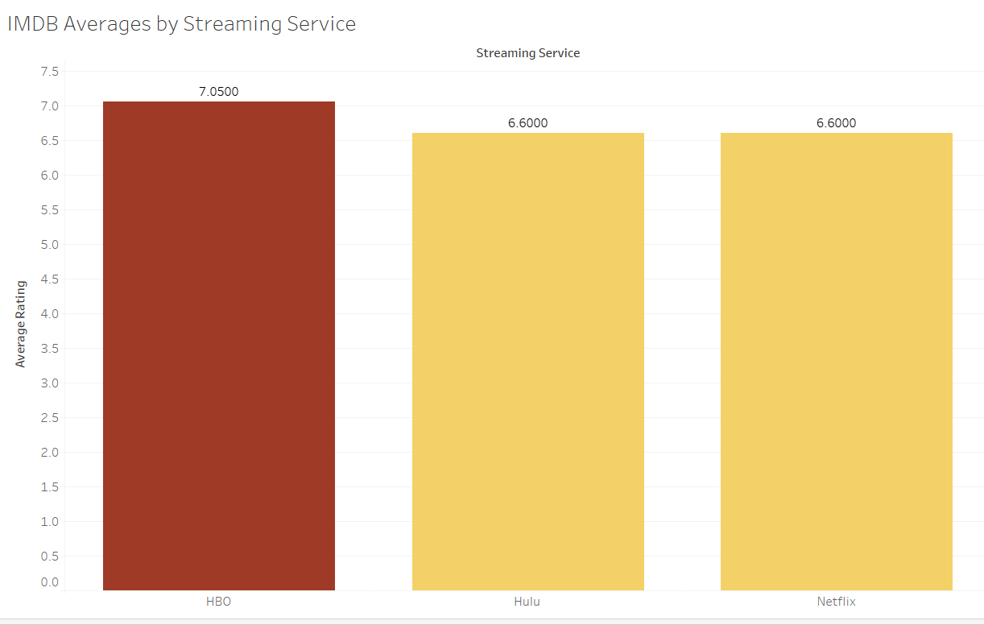
Which Streaming Service is the Most Popular?
HBO is the most popular streaming services according to IMDB scores
7.1
6.6
6.6
HBO
HULU
NETFLIX

Slide 59
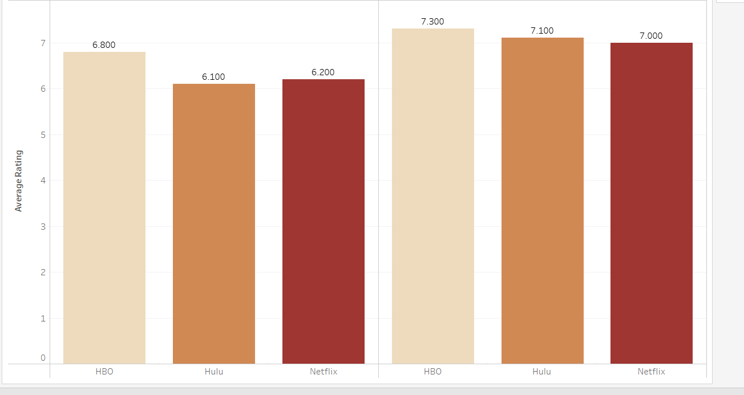
HBO has the highest ratings in both show and movie categories.
MOVIES
SHOWS
6.8
6.1
6.2
7.3
7.1
7.0
HBO HULU NETFLIX
HBO HULU NETFLIX

Slide 60
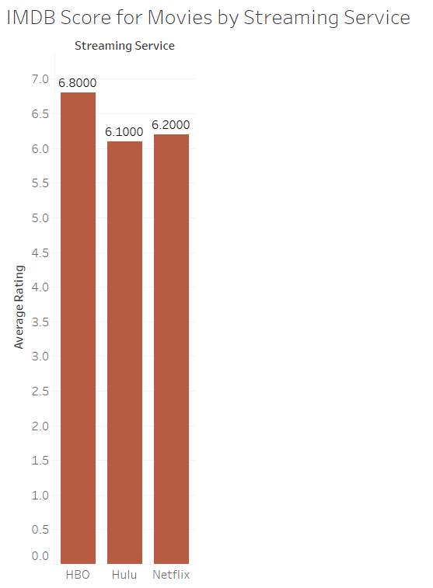
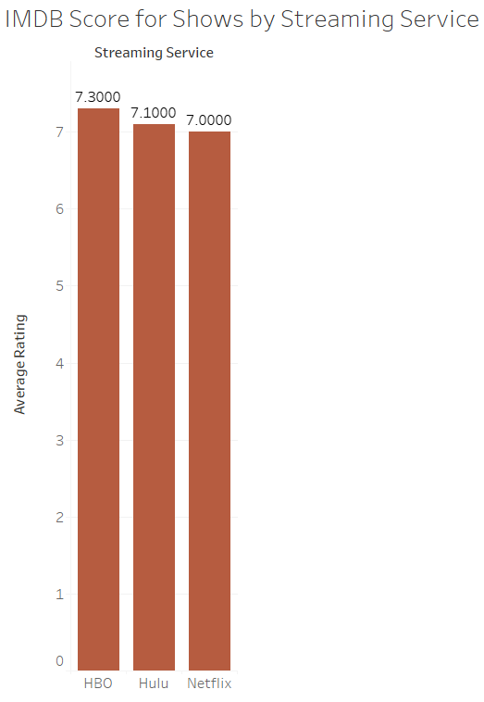
Streaming shows rate higher than movies.
MOVIES
SHOWS

Slide 61
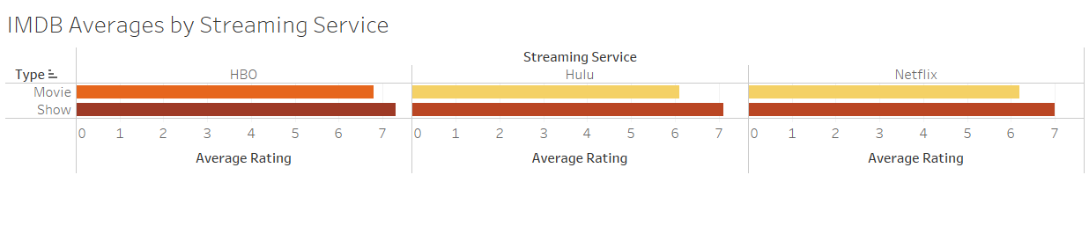
HBO really takes the lead with their movie content.

Slide 62
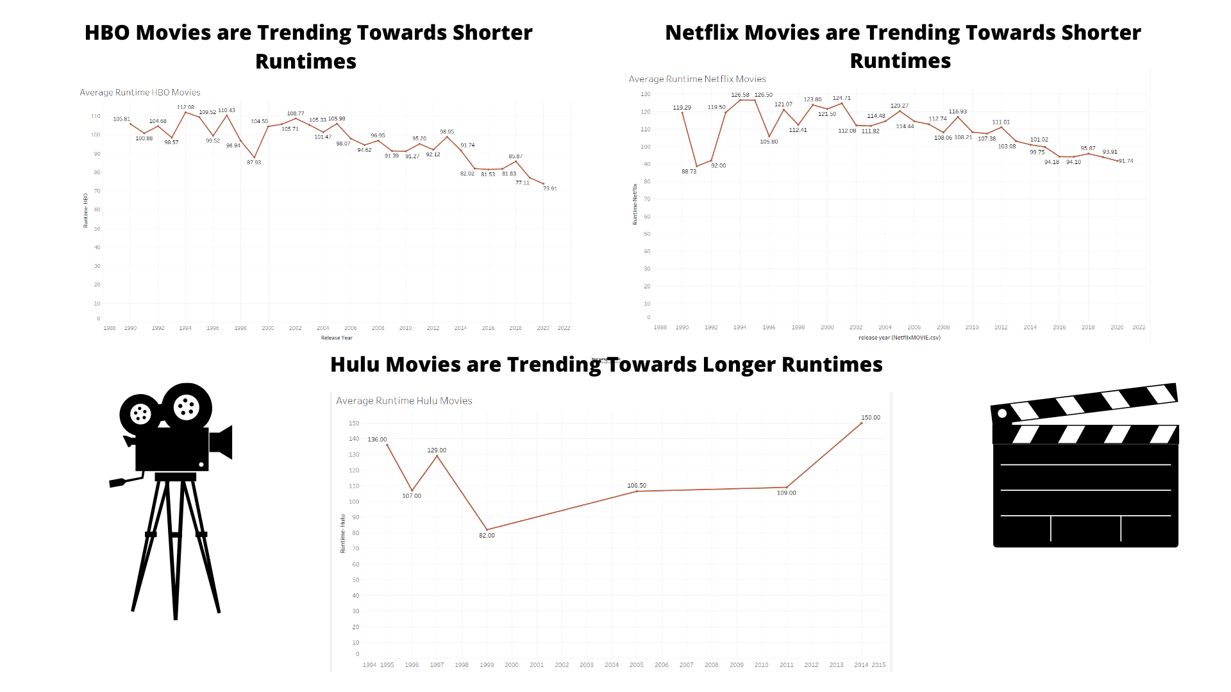
Hulu is the only subscription service who is trending towards longer runtimes.

Slide 63
Summary of Observations
Overall streaming services shows scored significantly higher than movies.
HBO has higher scores across shows, movies and overall than both Hulu and Netflix.
When looking at runtimes over all media forms through the decades Netflix and HBO both trend towards shorter runtimes while Hulu is trending towards longer runtimes.

Slide 64
Netflix Conclusion
Netflix seems to be dipping in popularity overall, as seen by their IMDB scores being on par or less than HBO and Hulu, as well, as the unprecedented dip in their overall subscribers in 2022.
While still widely used and very popular Netflix will need to work to adapt to the increased competition from competing streaming services.
Focusing on shows over movies, and in particular shows for mature audiences would play into Netflix’s strengths.
Reworking their programming for children and families as well as their movie selection could help to raise scores that are low.

Slide 65
Hulu Conclusion
Hulu is the leading online streaming service and comprehensive all I one premium service that offers an expansive slate of live and on demand. Over the past few years Hulu seen to be gaining more subscribers due to it’s live Tv streaming of sports and other movie services it offers
There are sill several other companies that are joining the online streaming game, so it would be interesting to see how Hulu stand against them all.

Slide 66
HBO Conclusion
We were able to show how movie and show times changed throughout the decades.
We were also able to show how average popularity ratings compare amongst the popular streaming services. We performed T-test using the out separate data set's averages as mu and your data set's average as the sample mean.

Slide 67
References
https://mobilemarketingreads.com
https://backlinko.com,forHuluiewshipandsubscriberstatistics
https://Businessofapps
35 Streaming Services Statistics You Need to Know in 2022 (cloudwards.net)
Netflix Revenue and Usage Statistics (2022) - Business of Apps

Slide 68
Questions?

